Slide 1
SRO role as first responder to a barricade, suicidal or hostage situation
Retired SRO “Officer Adam” Gongwer
SRO Basic, 2023

Slide 2
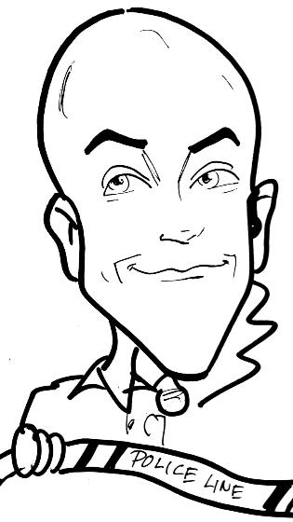
SRO Adam Gongwer
15.5 years with Ontario Police (Ohio)
10 years as SRO
HNT Member (2006)
DARE Class #61 (2009)
Education Liaison / Board of Directors
Ohio SRO Assoc. (OSROA.org)
Previous Experience:
JV Corrections Officer
Youth Minister
Family:
4 Kids
Married 32 years

Slide 3
Past Training received:
OPOTA Basic HNT 40 hrs
OPOTA Advanced HNT 40 hrs
FBI Basic HNT 40 hrs
Crisis Intervention Team 40 hrs
PATC Phase I HNT 40 hrs
PATC Phase II & III HNT 40 hrs
PATC Phase IV Recert 8 hrs
School Safety Seminar 16 hrs
OPOTA Scenario House (x2) 72 hrs
Notes:
Training received since 2006

Slide 4
Department Policy?
What does your policy say about crisis situations and first responders?
Today is a conversation starter….
HNT vs. CIT
Active shooter vs. hostage/barricade situation
Notes:
Review department policy to see what it says about HNT/CIT response. Active shooter is a live event where bullets are still flying and people are under attack. Hostage/Barricade has the potential for becoming an active shooter situation but we have time on our side to slow down the process. If it turns into an active shooter then SWAT or Police action becomes necessary.

Slide 5
Today’s Overview
Role as first responders to a school crisis
1
What role do you play for HNT/CIT?
2
Establish communication as well as gathering intel
3
Notes:
Three main goals for today’s conversation.

Slide 6
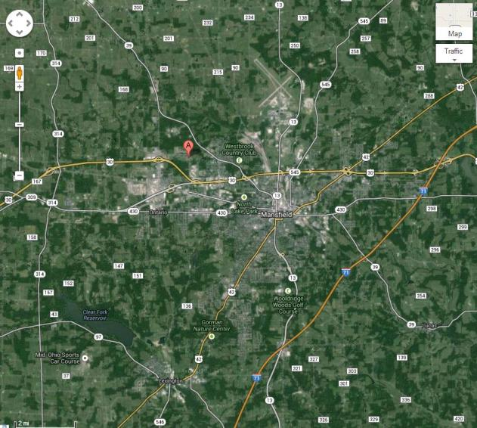
Oct 2013, Ontario OHIO
To Cleveland
To Columbus
Notes:
SRO being involved in a HNT event scenario. Ontario is located halfway between Cleveland and Columbus Ohio. Population of about 6,000 residents. Located beside Mansfield which has about 50,000 residents.

Slide 7
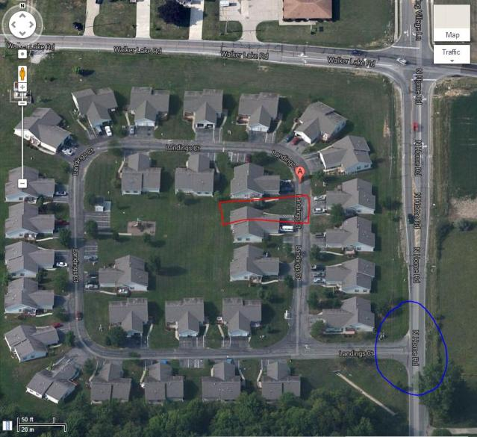
Oct 2013, Ontario OHIO
Notes:
Landings Court is a subdivision with several duplexes. Located on a busy intersection with only one entrance/exit (circled in blue). The probation violator was last seen in the duplex circled in red. He had a warrant for aggravated arson, attempted aggravated murder and attempted murder from an event that occurred in Mansfield earlier in the day.

Slide 8
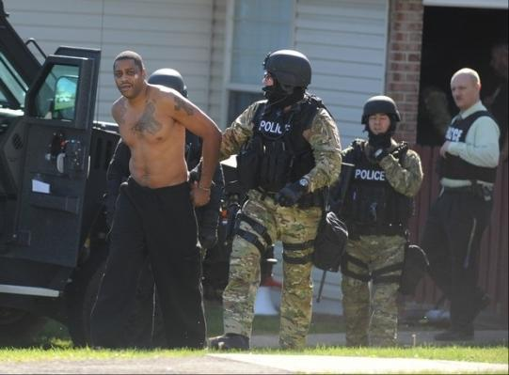
Oct 2013, Ontario OHIO
Davis became a suspect in a fire on the 800 block of Danwood Road around 7 a.m. after he fled from the scene and refused to cooperate with police.
Davis reportedly was watching his two children, ages 9 and 13, at the home when he set the kitchen stove on fire.
Samuel L. Davis, 41, was found asleep on the couch at 995 Landings Court after the new girlfriend reported his statements to police. Allied Special Operation Response Team served three warrants at the home charging aggravated arson, attempted aggravated murder and attempted murder. Davis’ record shows multiple charges for substance abuse, including an incident in 1992 in which he was charged with drug trafficking and CCW.

Slide 9
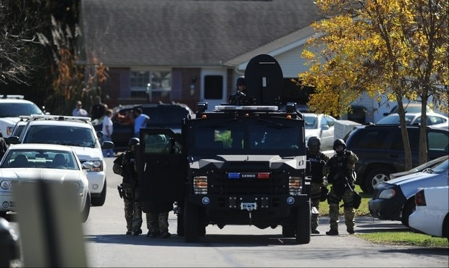
Oct 2013, Ontario OHIO
Notes:
SWAT setup on the only road into the complex. Neighbors began pouring out and watching the activity.

Slide 10
Oct 2013, Ontario OHIO
Notes:
I was notified by HNT to help assist in getting the children off of the bus and to their homes within the complex. HNT wanted a friendly, known face to reassure the children that everything was ok during the event. The buses were told to drop off at the entrance (circled in blue).

Slide 11
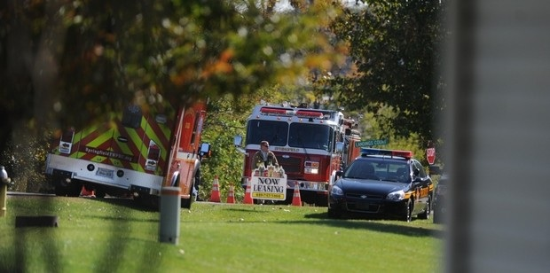
Oct 2013, Ontario OHIO
Only entrance/exit for Landings Court. Students getting off of the bus who
Live In the neighborhood while SWAT and HNT are activated.
Notes:
A total of three buses had dropped off students over one hour.

Slide 12
Could this lead to a crisis incident?
Disgruntled Parents
School Bus
Teacher’s death
Evacuation Panic
Labor unrest
Ethnic disturbance
Drunk staff or students
Student uprising
Terrorism

Slide 13
Could this lead to a crisis incident?
Disgruntled Parents
Kansas City Elementary School: The enraged mother of a kindergartner stormed into her child’s classroom. She allegedly punched her kid’s teacher in the face, grabbed her by the hair and slammed her head twice into a file cabinet
Donalsonville, Ga. Elementary School: during Teacher Appreciation Week in May, a 49-year-old mother allegedly beat a teacher with a broomstick and pulled her screaming down a hallway by her hair. The spark that set it off was the teacher’s insistence that the woman have a visitor’s pass to be in the building.
A woman and her two daughters were arrested in 2013 for allegedly beating a Los Angeles middle school teacher during the school day in a dispute over scheduling.
2013 Springtime, after breaking up a fight between two fourth-graders, a substitute teacher in Brooklyn allegedly was pummeled by the father of one of the boys. The man accused the teacher of choking his son during the altercation.
kansascity.com/2013/09/14/4481648/when-parents-abuse-teachers.html

Slide 14
Could this lead to a crisis incident?
School Bus
Jacksonville, AR 2013: Male, 22, hijacks elementary bus with a knife, 10 mile pursuit (20 min). Had tried carjacking a car…
one where a student used a sword to hijack a bus and take it across state lines before he was stopped
A Miami Special Needs bus driver was fooled into taking her bus and students on a 75-minute ride by a hostage-taker who forced his way on the bus but did not actually have a weapon
School bus driver holds 11-year-old hostage on the bus (Minneapolis)
safehavensinternational.org/SchoolBusTerrorism.php

Slide 15
Could this lead to a crisis incident?
Teacher’s death
Chism (14 yoa) admitted to police that he had followed Ritzer (24 yoa) into a women's bathroom at the school, punched her in the face, and slashed her throat with a box cutter. Chism then put the teacher's body in a recycling bin and brought it to the woods near the school.
foxnews.com/us/2013/10/24/all-public-schools-in-massachusetts-town-closed-for-homicide-investigation

Slide 16
Could this lead to a crisis incident?
Evacuation Panic
An early morning fire at Barwise Junior High School delayed classes and caused a temporary panic. The fire broke out at around 7:30 am, just as many students were arriving on campus. School officials evacuated those who were already in the building to the schools track.
newstalk1290.com/fire-forces-evacuations-at-barwise/

Slide 17
Could this lead to a crisis incident?
Labor unrest
Thousands of public school teachers marched in downtown Chicago and parents scrambled for child care during the first teachers' strike in a quarter century over reforms
Some 29,000 teachers and support staff in the nation's third-largest school system were involved, leaving parents of 350,000 students to find alternative supervision
reuters.com/article/2012/09/10/us-usa-chicago-schools-idUSBRE8870DL20120910

Slide 18
Could this lead to a crisis incident?
Ethnic disturbance
As told by one student…..Knives rule the playgrounds, inter-racial violence soars….
scared of children from other ethnic backgrounds and of the blades that are now being used
20 kids would wait for me at the school gates and beat me up
picked on for having poor English. The perpetrators were often Asian gangs
theguardian.com/uk/2006/jun/04/race.schools

Slide 19
Could this lead to a crisis incident?
Drunk staff or students
Robin Barnhill, a sixth-grade language arts teacher at the Maxton school, had a BAC of .34
put Barnhill at risk of dying from alcohol poisoning
charged with two counts of the possession or consumption of fortified wine, liquor or mixed beverages on unauthorized premises
robesonian.com/news/home_top-news/2669868/Teacher-charged-with-being-drunk-at-school

Slide 20
Could this lead to a crisis incident?
Student uprising
A brawl involving dozens of students at a Philadelphia-area high school has resulted in the arrests of six teens
The melee broke out in a hallway outside the cafe
bad blood between a couple of groups at the nearly 4,000-student school. Anywhere from 60 to 70 students were involved in the brawl but only a handful were arrested
nbcphiladelphia.com/news/local/Upper-Darby-High-School-Riot-228169681.html

Slide 21
Could this lead to a crisis incident?
Terrorism
September 2004
Beslan (Russia) school hostage crisis
lasted three days
over 1,100 hostages: including 777 children
death of over 380 people
en.wikipedia.org/wiki/Beslan_school_hostage_crisis

Slide 22
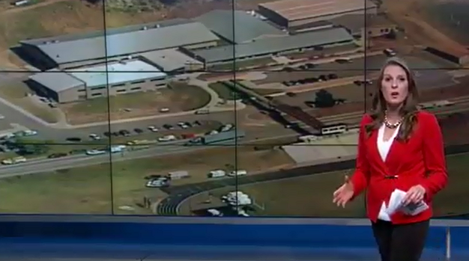
Recent major School HNT events
2006: Platte Canyon, CO High School
53 year old male, took 6 females hostage
Killed one, then himself
youtube.com/watch?v=5iM9eLUXmig
Notes:
Beslan was mentioned earlier, and other major events can be found online.

Slide 23
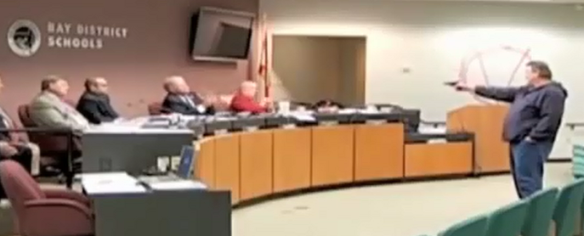
Recent major School HNT events
2010: Panama City School Board Shooting
56 year old ex-convict, over 12 shots
Upset that his wife had been fired by the board
https://youtu.be/ZMTIH3-O1Ro
Notes:
Beslan was mentioned earlier, and other major events can be found online.

Slide 24
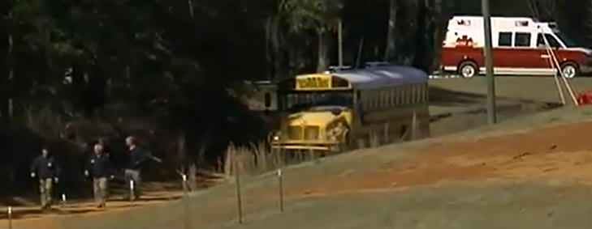
Recent major School HNT events
2013: Dothan, AL kidnapping from bus
Bus Driver killed, 5 year old boy kidnapped
7 days in a bunker, 65 year old Vietnam vet
youtube.com/watch?v=X_akOqVtxz4
Notes:
Beslan was mentioned earlier, and other major events can be found online.

Slide 25
HNT Team Setup and Roles
Primary: builds rapport with suspect
Secondary: monitors primary, gives feedback
Intel: gathers and delivers intel to commander
Scribe: chronological log of all events
Commander: confers with other commanders
Notes:
Most HNT models follow this structure.

Slide 26
Top Priorities
Officer Safety 1st!
Scene management
Perimeters
Evacuation of bystanders
Avoid face-to-face
Preservation of life (all lives)
Containment
Surrender
Arrest
Protection of property
Notes:
The preferred chronological priorities of the event if possible…

Slide 27
YOU, our biggest asset
Gather Intel
Interviews
student records/phone #’s
discipline records & known associates
guidance/admin connection
OLEA liaison
school cameras & Lockers, sketch of the room
social media
5 W’s
Notes:
SRO has many valuable assets at their disposal during a crisis. Make sure you know how to log into your school records remotely (over the internet), have phone numbers in your cell phone contacts, have dispatch log into camera system, etc.

Slide 28
Philosophy of Crisis Negotiation
Self Control:
If you can’t control yourself, you can’t control the situation
Approach:
Lower tension by: the process, understanding, effective listening, respect
Empathy:
Eyes of suspect, absorb tension, your tone indicates your attitude
Process:
Agree without conceding, problem-solving, don’t argue, context
Obstacles:
Losing face, unmet needs, not vested/ready for agreement, misunderstood, maligned
Basic Human Needs:
Security, Recognition, Control, Dignity, Accomplishment
Notes:
Philosophy of Crisis Negotiation
16 Min

Slide 29
5 Truths (regardless of culture)
All want to be respected / treated with dignity
Disrespect = fight
Asked rather than told to do it (ask = respect)
Tell them “why” up front to get cooperation
Options instead of threats
May allow person to save face
All want a second chance if available (Save Face?)
Remember Officer safety is first!!
Notes:
Communication Suggestions
28 Min

Slide 30
3 Communication Arts-Aristotle
REPRESENTATION: Your department, not you
You are a mouthpiece for an organization, not your ego
You are part of a larger group, you are the bigger image
Ethical Appeal
TRANSLATION: Correct words, not misunderstanding
Content, into words, spoken, then interpreted
Logical Appeal
MEDIATION: Helping them see something “new”
You educate, making sense by putting into perspective
Emotional Appeal
Notes:
Communication Suggestions
29 Min

Slide 31
Quick Tips/Basic HNT for SRO’s
Buy time, slow it down
initiate communication if safe
Avoid saying “No” but not off limits
assume nothing, do not make suggestions
ask if subject/others are ok, do not set a deadline
be honest, non-threatening/non-judgmental
don’t make promises you can’t keep
ask him to come out/surrender
if he is talking, you should be listening (ALS)
stick around: HNT needs you for intel, rapport
Notes:
the word "no" can be a trigger word to some. But it is not off limits, especially if put into a question like "do you want me to kill these people?“
Be yourself.

Slide 32
Should NOT be done:
Induce drugs into food or beverages
Provide alcoholic beverages
Negotiate for the exchange of people
Disarm police members
Give weapons of any kind to the perpetrator(s), including “dummy” weapons
Do not show over concern for the welfare of the hostage(s)
Do not agree to the release of any individuals from your custody whose freedom the perpetrator(s) seeks

Slide 33
Negotiation Strategy & Tactics
Intel: basics you would normally get on any call
Establish Problem-Solving Climate
Build Trust (will eventually help pursuade)
Avoid Forcing “Your” Climate
Attempt to calm the subject: words, tone, voice
Attempt to distract from original problem
Stall for Time
Notes:
Negotiation Strategy & Tactics
35 Min
Whisper during a verbal argument and see if it lowers the other’s voice

Slide 34
Negotiation Strategy & Tactics (cont)
Avoid arguing/provoking
Help suspect “Save Face” (not lose)
Active Listening
Deal with smaller issues first: build foundation
Present both sides of the argument: objective
Point out Similarities: rapport and trust
Delayed Compliance: think about it, sleep on it
Keep hope alive: of winning for both sides
Notes:
Negotiation Strategy & Tactics
35 Min

Slide 35
Negotiation Words and Phrases
Could you tell me about it?
I would like to hear your side.
Could you share that with me?
I guess that’s pretty important to you.
That’s interesting, tell me more about …
Together, we can work this out.
Notes:
Negotiation Strategy & Tactics
37 Min

Slide 36
Avoid
Today
Notes:
12 Min

Slide 37
JV Deliberate/Planned Behavior
REMIND:
Subtle words/signals, non-threatening, private/quiet
i.e. “I understand you without swearing…”
EXPLAIN:
Simple, non-threatening consequences, “if-then”, your choice
INSTRUCT:
Clear, Firm, Courteous, Facts
Directions to quickly correct behavior
State Specific issue at hand and effects of mis-behavior
http://de-escalate.org/
Notes:
JV De-Escalation from http://de-escalate.org/
41 Min

Slide 38
JV Emotional/Impulse Behavior
SPACE/TIME:
To vent, show respect, non-threatening, don’t crowd
REFLECTIVE LISTENING (Active):
Shows comforting, reaffirming, don’t disagree
More verbal = less physical
POSITIVE OPTIONS:
Ask them for positive options available
Try not to suggest unless they don’t have any
http://de-escalate.org/
Notes:
JV De-Escalation from http://de-escalate.org/
44 Min

Slide 39
Active Listening Skills
Can you repeat the part of the stuff
where you said all about the things?
https://www.youtube.com/watch?v=d8Xb18sljTg

Slide 40
Active Listening Skills
Show interest in what is being stated
If they mention it, it IS important
See & Understand their “perspective”
Listen more than talk
Listen carefully to what is being stated
Listen for emotions
Listen for content (the story)
Frederick J. Lanceley, Director, Crisis Negotiation Associates, Inc
Notes:
Want them to know how difficult it is to negotiate a point that you personally don't agree with like religion. Or even more difficult, negotiate a point that makes no sense because the suspect took drugs/alcohol or they didn't take prescribed pills and now they want to argue why chickens are actually amphibians and not reptiles because McDonalds is closed.

Slide 41
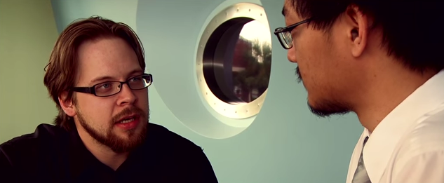
Active Listening Video Clip
A twist on the trailer for Inception…..
https://www.youtube.com/watch?v=MkyD2Zh3dx4

Slide 42
Active Listening Skills #1
Emotion Labeling
Respond to the emotions that are “heard”
Identify the feeling
You sound…
You seem…
I hear...
Demonstrates YOU are listening to them
Listen for conflicts
Be aware of missing emotions

Slide 43
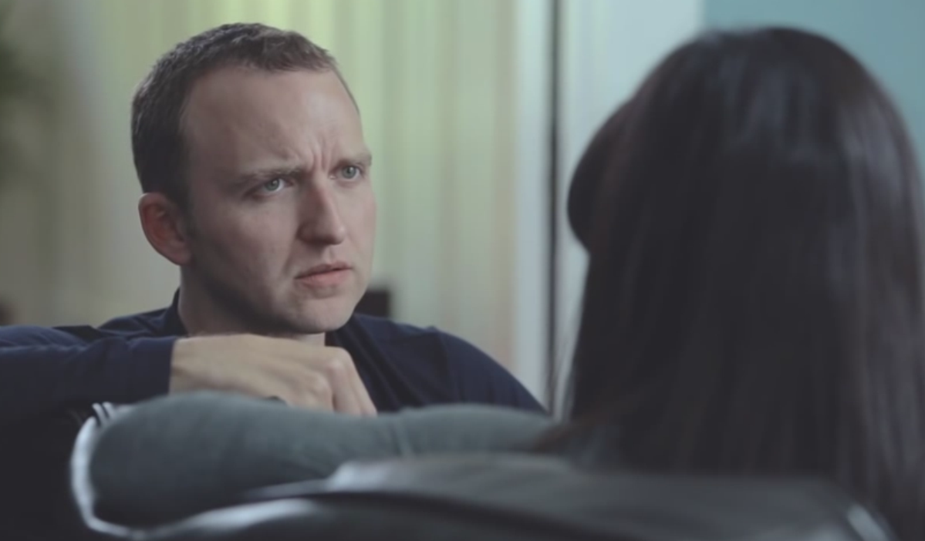
Emotional Labeling
Using Empathy: Video
https://youtu.be/-4EDhdAHrOg

Slide 44
Active Listening Skills #2
Paraphrasing
Restatement
Summarize what you just heard
Clarifies what has been stated
Creates empathy and rapport
Makes suspect non-defensive by using their words
Are you saying…
Are you telling me…

Slide 45
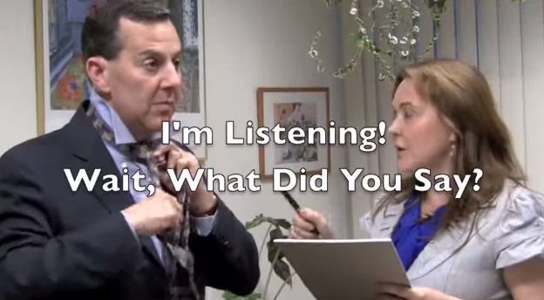
Paraphrasing Video (good)
https://www.youtube.com/watch?v=bO-a-Yz4xA8

Slide 46
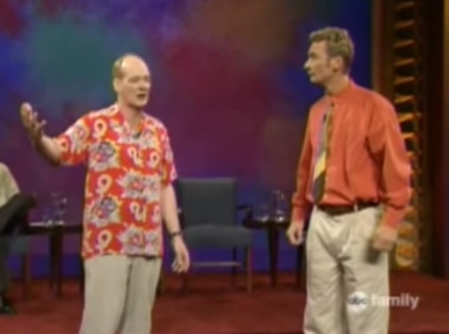
Paraphrasing Video (bad)
https://youtu.be/i2uD81BD8OI

Slide 47
Active Listening Skills #3
Reflecting/Mirroring
Repeating back the last word or phrase said by suspect
Asks for more intel without guiding direction

Slide 48
Reflecting/Mirroring
https://www.youtube.com/watch?v=4VOubVB4CTU

Slide 49
Active Listening Skills #4
Effective pause (silence)
Most people feel awkward with silence
Can provoke the suspect into talking
Use before and after YOU have communicated an important message (intensifies meaning)

Slide 50
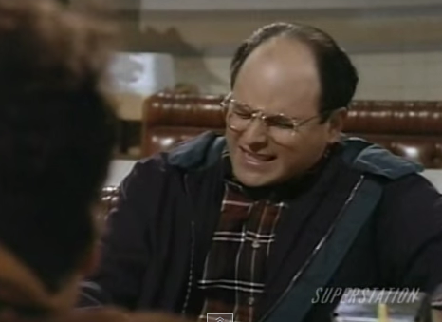
Effective Pause (Example)
https://www.youtube.com/watch?v=0u8KUgUqprw

Slide 51
Active Listening Skills #5
Minimal encouragers
Sounds you can make showing your interest
“Oh”, “When”, “Really?”, etc
Does not interfere with conversation flow
Helps build rapport
Encourages the subject to continue TALKING

Slide 52
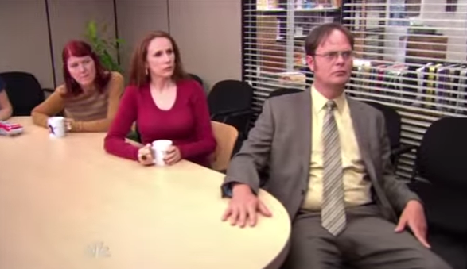
Minimal Encouragers
https://www.youtube.com/watch?v=yt96focL_oc

Slide 53
Active Listening Skills #6
“I” messages
Shows how you are interpreting what is being said
Non-threatening approach
Why we feel a certain way
What they can do to help remedy situation
Can slow down manipulation and verbal attacks
I feel….when you…..because…..
I feel uneasy about that request….
I feel hurt when you…..

Slide 54
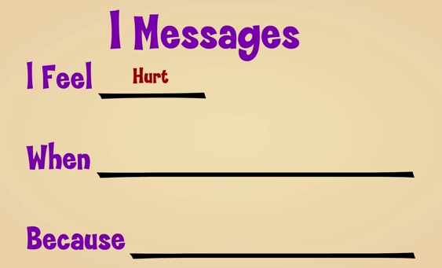
“I” Messages
https://www.youtube.com/watch?v=bYf3H70qldI

Slide 55
Active Listening Skills: 5 W's
Open ended questions
5 W’s + How
Cannot be answered with “Yes” or “No”
Provokes conversation
Demonstrates interest in their feelings
Closed ended questions gives appearance of interrogation

Slide 56
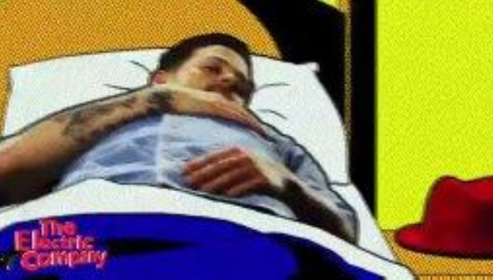
5 W’s
youtube.com/watch?v=UrrMEex1_lg

Slide 57
Active Listening: You!
Two Levels of communication:
Content
Emotion (CRISIS)
Be yourself!

Slide 58
Active Listening Skills: Time
STALL for TIME
Decreases stress levels
Increases rational thinking
Permits time for intel gathering
Gives HNT time to respond
Builds Rapport
Notes:
The most dangerous times for crisis are the first 45 minutes and the surrender/completion. If we can stall for time, we can allow SWAT to deploy, emotions to come down, humanization of the hostages, etc…

Slide 59
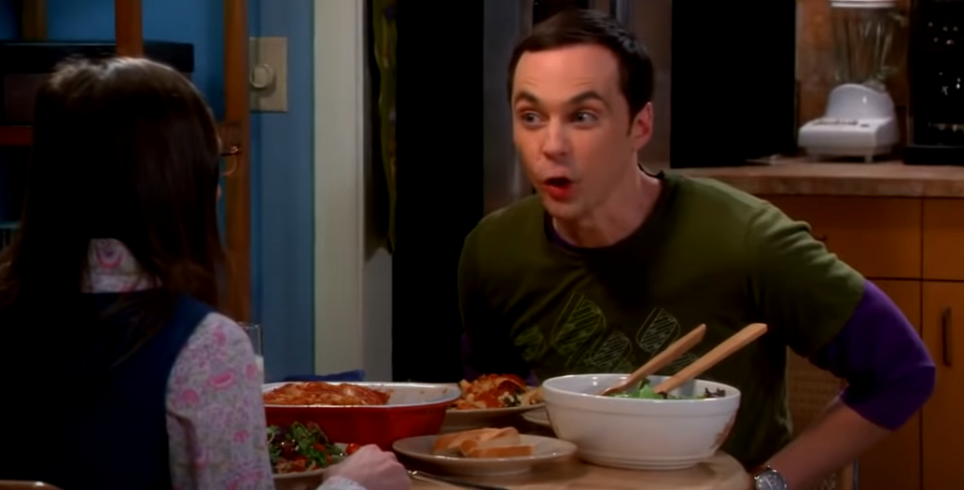
Review
PS4 vs Xbox
www.youtube.com/watch?v=a91T8MdXXMc

Slide 60
SRO Transition to on-scene HNT
1st Responders DO NOT replace trained HNT
Transfer to Team:
Written notes
Evidence
Demands (If any)
Suspect intel, location, background, etc
Help with witnesses
Introduce Primary to Suspect
Possible use as T.P.I. (Third Party Intermediary)?
Notes:
Do not leave the scene. SRO’s as first responders can assist even after the transition.

Slide 61
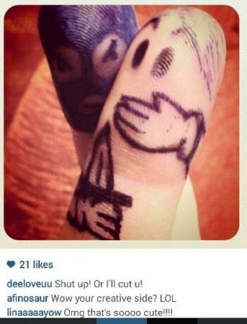
What to do if taken hostage

Slide 62
What to do if taken hostage
(or what to tell others if they are taken hostage)
If “Run, Hide Fight” or “A.L.i.C.E.” is not available
“Hostage Cop”
author Frank Bolz
NYPD Hostage Negotiator
Notes:
If somehow you or others are taken hostage, the following tips may be necessary….

Slide 63
“The First 15-45 Minutes Are The Most Dangerous”
Follow instructions.
The beginning of the incident is the most dangerous to all concerned.
Captor is highly emotional.
He is in a fight or flight reaction state.
Stockholm Syndrome (transference) develops.
You are trying to stay alive.

Slide 64
“Don’t Be A Hero”
Accept your situation.
Time is a real ally.
Any drastic action on the part of the victim might bring immediate violent action from the captor.
Be prepared to wait for rescue.

Slide 65
“Don’t Speak Unless Spoken To & Only When Necessary”
Captor likely agitated and not wanting additional stimuli.
Try not to be hostile but do not be overly friendly or phony.

Slide 66
“Try To Rest”
Try to get as much rest as possible without turning your back on the captor.
Anxiety will be high and he will be in a higher state of perception.
Fatigue (psych & physical) will eventually effect the captor.

Slide 67
“Don’t Make Suggestions”
If your suggestions go wrong, the captor may believe that was your plan.
Negative transference can occur as a result.
You may become a visible enemy.

Slide 68
“Escape: Should You or Shouldn’t You?”
Consider the likeliness of your success.
If you fail, what may the captor do.
What will be the consequences if you do not escape.
What will be the consequences if you are captured trying to escape.

Slide 69
“Special Medication or Aid”
Be matter of fact about this.
The captor may not want additional stressors or victims.
Don’t become a pest about it.

Slide 70
“Don’t Be Argumentative”
Don’t create agitation with the captors or other victims.
Non-cooperation may cause harm and can be perceived as aggression.

Slide 71
“Be Observant”
You may be released or escape & can help the police.
Memorize all you can about the captor.
Voice, language, weapons, names, causing event, eating & drinking routine, sleeping, focus on particular victims, injuries.

Slide 72
“Treat the Captor Like Royalty”
Don’t turn your back on the captor unless ordered to.
Don’t stare at the captor.
Don’t “look down” to the captor.
A captor is less likely to harm someone with whom he has eye contact. (Exceptions exist)

Slide 73
“Be Prepared to Answer the Police on the Phone”
Try to answer with yes or no.
If the captor is listening, you can warn police by saying, “Don’t lie to us because he can hear what you are saying.”
Try to tip police when you are forced by the captor to lie (i.e.: My brother…and you don’t have one…)

Slide 74
“If a Rescue Comes….”
If you believe it is occurring, hit the floor and stay down!
If you hear shots or noises (flash-bangs), hit the floor and stay down!
Keep your hands on your head and don’t make any abrupt moves.
Follow directions.
Be prepared to be frisked & cuffed.

Slide 75
“Be Patient”
Police will be doing many things to maximize the chance to save your life.
It may take a lot of time.
Be prepared to wait.
Take advantage of times to eat, drink and use the bathroom.

Slide 76
What Are My Chances
These guidelines are based on successful actions.
You may have to use your knowledge, skills, abilities and trust your instinct.
Final decisions are made by you.

Slide 77
Ultimate Goal
SURVIVE

Slide 78
Early Warning Signs/Violence

Slide 79
Early Warning Signs/Violence
Neola Policy 8410a
Social Withdrawal
Excessive feelings of isolation, rejection
Victim of violence/abuse
Feelings of being picked on and persecuted
Low School interest/poor academics
Expression of violence in writings/drawings
Uncontrolled anger, impulsive hitting, threats
History of discipline problems, violent behavior
Intolerant or prejudiced
Drug & alcohol use, gangs
Access to or infatuation with weapons

Slide 80
Resources
Verbal Judo
George Thompson

Slide 81
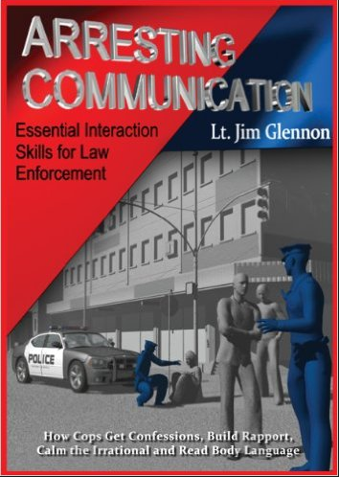
Resources
Arresting Communication
Lt. Jim Glennon

Slide 82
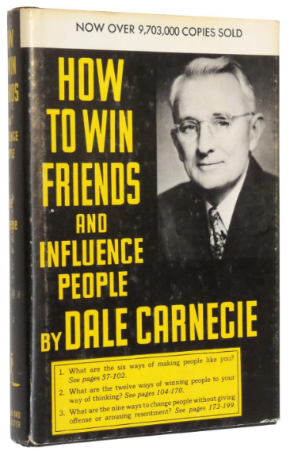
Resources
How to Win Friends & Influence People
Dale Carnegie

Slide 83
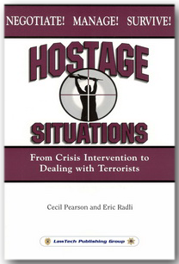
Resources
Hostage Situations
Cecil Pearson, Eric Radli

Slide 84
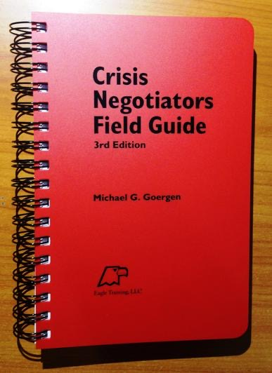
Resources
Crisis Negotiators Field Guide (Eagle Training)
Michael G. Goergen

Slide 85
Resources
School Scenario PDF link:
training.fema.gov/EMIWeb/emischool/ EL361Toolkit/assets/HostageScenarioInstructor.pdf
Public Agency Training Council
PATC.com
OPOTA
ohioattorneygeneral.gov/Law-Enforcement/ Ohio-Peace-Officer-Training-Academy

Slide 86
Questions?
Retired Officer Adam Gongwer
Ontario, Ohio Police
SRO@SRO101.com
419-571-1031
Download this powerpoint:
Sro101.com (click on downloads)

