Slide 1
theoretical school safety drill
Student-Parent Reunification
SRO Gongwer, “Officer Adam”

Slide 2
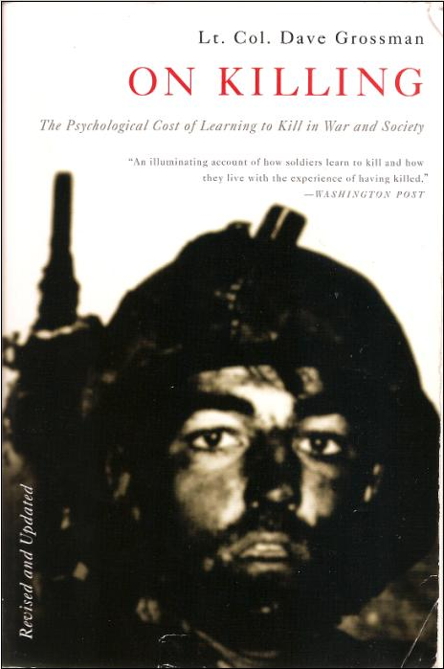
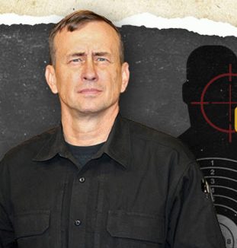
It will Never happen here…
Preparation does not cause anxiety, denial does….
Lt. Col. Dave Grossman. killology.com

Slide 3
State Law
ORC 3737.73 (HB 178)
6 Drills (Rapid Dismissal): monthly
9 Drills (Rapid Dismissal): if building does not have sprinklers
3 Safety Drills
threat to the school involving
an act of terrorism;
a person possessing a deadly weapon or dangerous ordnance
Lockdown (at least one) and evacuation
Theoretical School Safety Drill
Annual training required
Tornado Drills

Slide 4
Emergency Operations Plan
The Family Reunification Protocol is used to ensure a safe and secure means of accounting for students and reuniting parents/guardians with their children whenever the school facility or grounds is rendered unsafe and a remote site is needed.

Slide 5
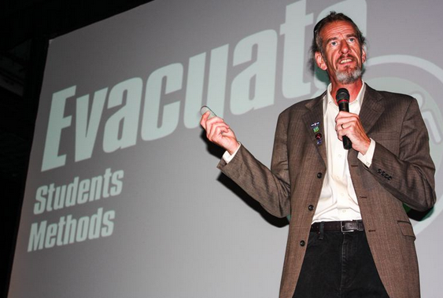
Recovery Starts when crisis begins
John Michael Keyes
Daughter Emily was killed in the Sept. 2006 Platte Canyon High School shooting
iloveuguys.org

Slide 6
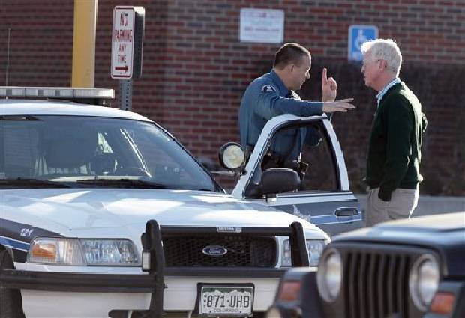
Cops own the crime

Slide 7
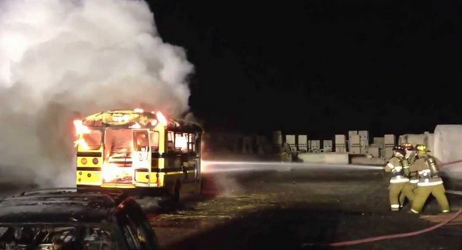
Fire owns the flames

Slide 8
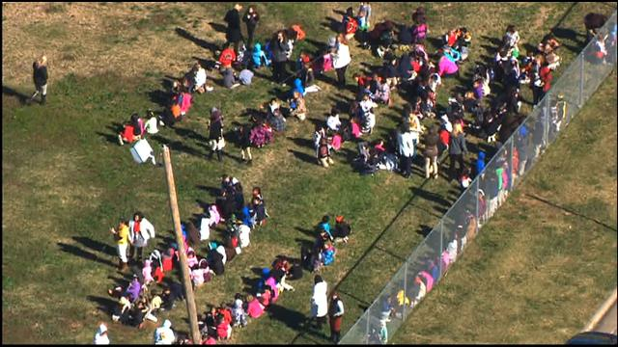
School owns the kids

Slide 9
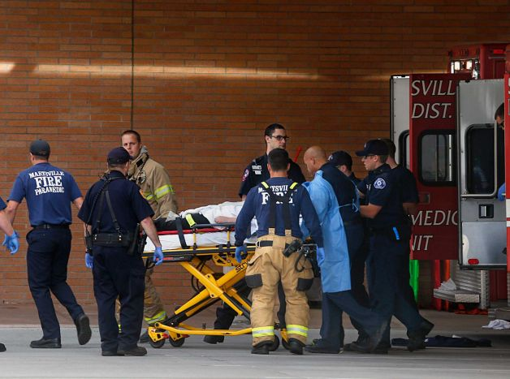
Paramedics own the patient

Slide 10
Incident command
The Event (Crime Scene): Police
Reunification (Away from scene): School

Slide 11
Incident command: Objectives
Student and Staff: safety and well-being
Student and Staff: whereabouts and condition
Student and Parent: successful reunification

Slide 12
Location
Lockout: Exterior incident
Reunification may occur inside building
Auditorium
Gymnasiums
Lockdown: Interior Incident
Reunification may occur outside after evacuation
Other School building
Marshall Park

Slide 13
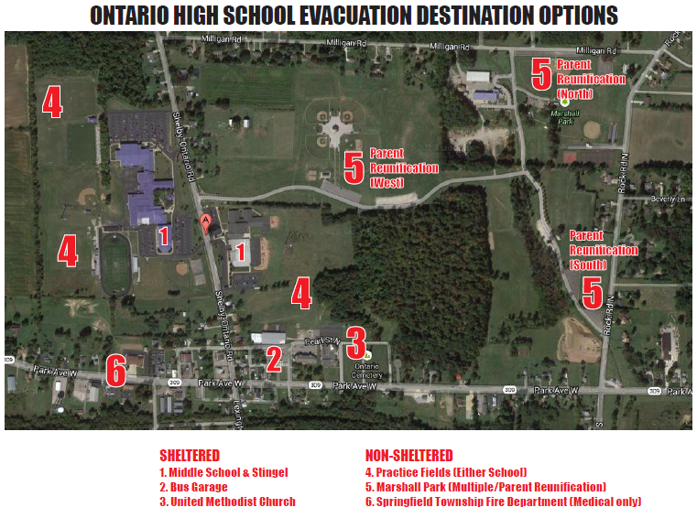
Map

Slide 14
assignments
Greeters
Talks to parents as they arrive
Assist with papers, pens, clip boards

Slide 15
assignments
Checkers
Verify custody
Parent forms

Slide 16
assignments
Runners
Fetch the kid(s)
What if they are not found?

Slide 17
assignments
Counselors
Intervene with impacted parents
Crisis team

Slide 18
assignments
Kid Wranglers
Classroom management

Slide 19
assignments
Entertainment
Keep them busy
No long movies if “shelter in place”

Slide 20
assignments
Scribe(s)
Records events and times
Incident Command
Medical Transport

Slide 21
assignments
Gatherer
Gathers supplies
Deploys signage
All-around gopher

Slide 22
issues
Bus Drivers? Where are they during the day
CDL: teachers trained to drive buses
Shelby-Ontario Rd & Rock Rd: 2 Lane Roads
Fire Alarm: Turn off remotely?
Searches: Students and staff during and after
Medical: students with diabetes/other
Network: wifi overload potential, student info access?

Slide 23
Where are the kids
Lockdown (have all been evacuated)
Self-Evacuation (walked away)
Absence list (accessible)
Medical transport (scribe? Which hospital)
Drive? (H.S. Students)
Suspect? (Police)

