Slide 1
Look in the Mirror Survey
On a piece of paper….
First Name, Assignment, Length of Service
Why are you here?
Are you an effective communicator?
Why aren’t you better?
What’s the most important communication skill?
What skill do most people lack?
Notes:
-15 minutes
As they come in……on screen

Slide 2
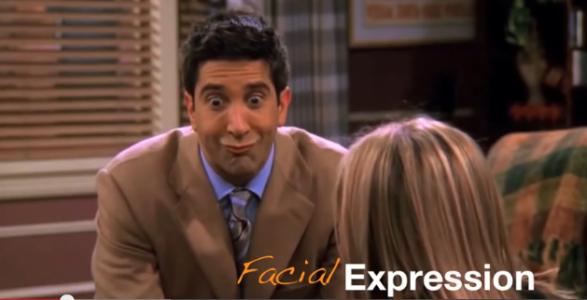
youtube.com/watch?v=OvEci5Bjgd4
Registration 4.5 Min
Notes:
-5 Min

Slide 3
SRO
Juvenile (& adult)
De-Escalation
Techniques
Retired SRO “Officer Adam” Gongwer
3/22/17

Slide 4
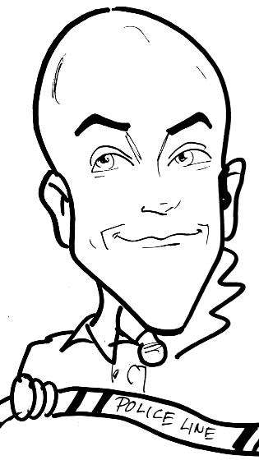
  SRO Adam Gongwer
    15.5 years with Ontario Police (Ohio)
    10 years as SRO
    HNT Member (2006-2021)
    DARE Class #61 (2009)
    Education Liaison: Board of Directors
      Ohio SRO Assoc. (OSROA.org)
    Previous Experience:
    JV Corrections Officer
    Youth Minister
    Family:
    4 Kids
    Married 31 years
Notes:
1 Min

Slide 5
Past HNT Training received:
OPOTA Basic HNT 40 hrs
OPOTA Advanced HNT 40 hrs
FBI Basic HNT 40 hrs
Crisis Intervention Team 40 hrs
PATC Phase I HNT 40 hrs
PATC Phase II & III HNT 40 hrs
PATC Phase IV Recert 8 hrs
School Safety Seminar 16 hrs
OPOTA Scenario House (x2) 72 hrs
Notes:
Training received since 2006
2 Min

Slide 6
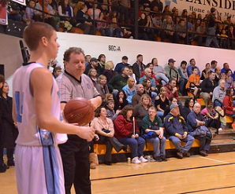
SCENARIOS
Basketball Game:
Fred’s Son, Ref call, prior issue
Write Down:
Does crowd play a role?
Racial?
How do you handle?
Notes:
4 Min

Slide 7
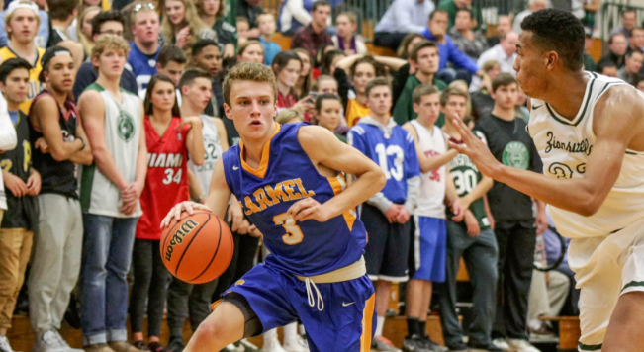
SCENARIOS
Basketball Game:
Students from opposing team
Come over to home side
Refuse to leave a “public” area
Write Down:
Does your school allow it?
How do you remove them?
Notes:
5 Min

Slide 8
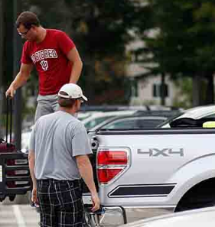
SCENARIOS
Suspended student:
Parking Lot, profanities
disorderly conduct, angry
Write down:
Do you go hands on?
Do you cite him?
Notes:
6 min

Slide 9
Look in the Mirror Survey
First Name, Assignment, Length of Service
Why are you here?
Are you an effective communicator?
Why aren’t you better?
What’s the most important communication skill?
What skill do most people lack?
(Turn them in)
Notes:
7 Min

Slide 10
Goals of De-Escalation
Tools?
Safety? (yours first, then others)
Relationships? (work vs personal)
Complaints (public scrutiny)
Notes:
7 Min

Slide 11
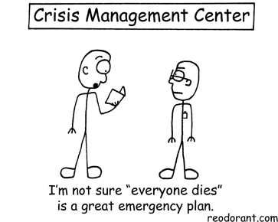
CRISIS, PEOPLE, COMMUNICATION
Notes:
8 min

Slide 12
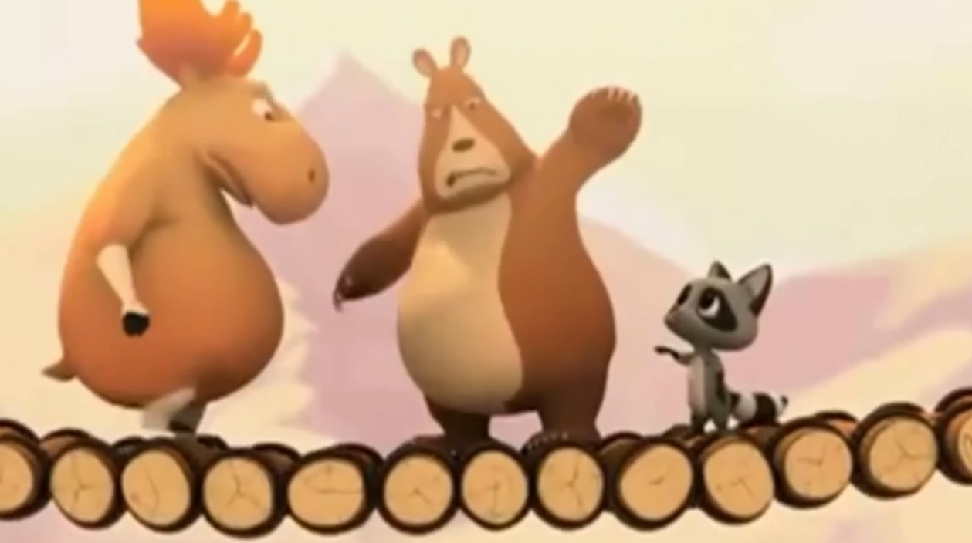
"Bridge" by Ting Chian Tey
Disney Favorite
https://youtu.be/_X_AfRk9F9w
Crisis, People & Communication 2.25 Min
Notes:
11 Min

Slide 13
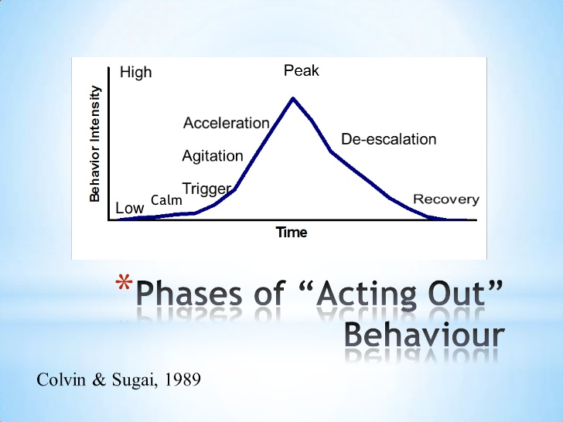
Avoid
Today
Notes:
12 Min

Slide 14

Could this lead to a crisis incident?
School Examples?
Others?
Disgruntled Parents
School Bus
Teacher’s death
Evacuation Panic
Labor unrest
Ethnic disturbance
Drunk staff or students
Student uprising
Terrorism
Notes:
Crisis
13 Min

Slide 15
Philosophy of Crisis Negotiation
Self Control:
  If you can’t control yourself, you can’t control the situation
Approach:
  Lower tension by: the process, understanding, effective listening, respect
Empathy:
  Eyes of youth, absorb tension, your tone indicates your attitude
Process:
  Agree without conceding, problem-solving, don’t argue, context
Obstacles:
  Losing face, unmet needs, not vested/ready for agreement, misunderstood, maligned
Basic Human Needs:
  Security, Recognition, Control, Dignity, Accomplishment
Notes:
Philosophy of Crisis Negotiation
16 Min

Slide 16
3 Types of People
Nice
  Yes men, don’t complain, cooperative
    Still treat with respect
Difficult or Manipulative
  Persnickety, Challenging, ask “Why”, What is in it for them?
    Welcome the opportunity to learn from the encounter
Wimps
  Sound like Nice people, Closet Difficult people
  Backstabbers, want revenge, Johnny Raincloud
    Be direct, nip it in the bud
Notes:
3 Types of People
18 Min

Slide 17
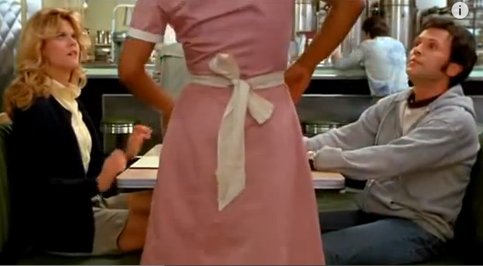
youtube.com/watch?v=IxeeeSUFpmE
Difficult People .5 Min
Notes:
18.5 Min

Slide 18
2 Ways to Deal with Difficult People
Let them say what they want….
  As long as they do what you say
  Focus on behavior not their attitude
  Nip any attempt at them inciting others though
Always go for the win/win solution….
  Give them the last WORD, you have the last ACTION
  They “save face”…….you don’t get “hurt”
Notes:
3 Types of People
19 Min

Slide 19
4 Tell-Tale Signs during a Crisis
What they Want? Who they Are? Intentions?
What the person is saying
  (what words are being used)
What the person isn’t saying
  (and determine why)
When the person is saying it
  (why now?)
How the person is saying it
  (the non-verbal)
Notes:
4 Tell-Tale signs during a crisis
21 Min

Slide 20
Communication Suggestions
Be Yourself, introduce yourself, explain “why”
Use active listening skills
Supportive when youth is rational
If you are not sure, ask!
Choose words, tone, and manner carefully
Speak slowly, softly and calmly
Ask open ended questions
Honesty builds credibility
Notes:
Communication Suggestions
24 Min
Yelling vs. Whispering example

Slide 21
Communication Suggestions
Dale Carnegie:
become genuinely interested in other people
a person’s name, the most beautiful sound to them in any language
Smile
Notes:
Communication Suggestions
25 Min
Bre example: Choir class, high fives, always smiles, contagious

Slide 22
Communication Suggestions
talk in terms of the other person’s interests
see things from the other person’s point of view
make the other person feel important—and do it sincerely
Notes:
Communication Suggestions
26 Min

Slide 23
5 Truths (regardless of culture)
All want to be respected / treated with dignity
  Disrespect = fight
Asked rather than told to do it (ask = respect)
Tell them “why” up front to get cooperation
Options instead of threats
  May allow person to save face
All want a second chance if available (Save Face?)
Remember Officer safety is first!!
Notes:
Communication Suggestions
28 Min

Slide 24
3 Communication Arts-Aristotle
REPRESENTATION: Your department, not you
  You are a mouthpiece for an organization, not your ego
  You are part of a larger group, you are the bigger image
  Ethical Appeal
TRANSLATION: Correct words, not misunderstanding
  Content, into words, spoken, then interpreted
  Logical Appeal
MEDIATION: Helping them see something “new”
  You educate, making sense by putting into perspective
  Emotional Appeal
Notes:
Communication Suggestions
29 Min

Slide 25
3 Communication Arts-Aristotle
ETHICAL Appeal (most encounters 80%)
  Does the following convey credibility, authority?
    Demeanor
    Words you use
    Appearance
    Behavior
    Do you introduce yourself?
    Respectful
    Fair
SurvivingVerbalConflict.com
Notes:
Communication Suggestions
30 Min

Slide 26
3 Communication Arts-Aristotle
LOGICAL Appeal (next 10%)
  Don’t have to agree, do not debate
    Deflect: Recognize what they said
    Empathize: See situation through their eyes
    Explain: They want to hear why
SurvivingVerbalConflict.com
Notes:
Communication Suggestions
31 Min

Slide 27
3 Communication Arts-Aristotle
EMOTIONAL Appeal (remaining 3-5%)
  Active Listening & Options (Persuasion at it’s highest)
    Paraphrase
    Reflecting
    Time Out?
    Aware of Hypervigilance?
    Phrase it so it is best for the youth
    Show how it benefits them (released, no fine, to work, etc)
    Give good options
SurvivingVerbalConflict.com
Notes:
Communication Suggestions
32 Min

Slide 28
11 Phrases Never to Say to Anyone
COME HERE!
Alternative:
  Excuse me, I need to chat with you….
  Could I chat with you a second?
Why not?
  Vaguely threatening
  “Run like the devil”
Notes:
11 Things Never to Say to Anyone
33 Min

Slide 29
11 Phrases Never to Say to Anyone
YOU WOULDN’T UNDERSTAND!
Alternative:
  This might be difficult to understand….
  Let me try to explain this….
Why not?
  “They are Stupid” implied at the end
  Insulting
Notes:
11 Things Never to Say to Anyone
34 Min

Slide 30
11 Phrases Never to Say to Anyone
BECAUSE THOSE ARE THE RULES.
Alternative:
  It’s my responsibility to do ______,
  I need your help to ____
Why not?
  Judges as insensitive, uncaring
  Concerned with your own authority vs. their welfare
Notes:
11 Things Never to Say to Anyone
36 Min

Slide 31
11 Phrases Never to Say to Anyone
IT’S NONE OF YOUR BUSINESS.
Alternative:
  The parties involved would not want me to say….
  I am honoring a request for confidentiality…..
Why not?
  Weak
  Brands them as outsiders, cut off
Notes:
11 Things Never to Say to Anyone
38 Min

Slide 32
11 Phrases Never to Say to Anyone
WHAT DO YOU WANT ME TO DO ABOUT IT?
Alternative:
  I’m sorry, I’m not sure what else to recommend…
  I’d like to help, but I can’t because…..
Why not?
  Evasion of responsibility
  Sarcasm
Notes:
11 Things Never to Say to Anyone
40 Min

Slide 33
11 Phrases Never to Say to Anyone
CALM DOWN!
Alternative:
  It’s going to be alright, talk to me
  What’s the trouble?
Why not?
  Criticism of their behavior, defensive
  Implies they do not have a right to be upset
Notes:
11 Things Never to Say to Anyone
42 Min

Slide 34
11 Phrases Never to Say to Anyone
WHAT’S YOUR PROBLEM?
Alternative:
  What’s the matter?
  How can I help?
Why not?
  Snotty, arrogant
  You vs. me, not “us”
Notes:
11 Things Never to Say to Anyone
44 Min

Slide 35
11 Phrases Never to Say to Anyone
YOU NEVER…..YOU ALWAYS…..
Alternative:
  I feel ____, when you ____, because _____
  I am ____, when you ____, because ____
Why not?
  Accusatory generalizations are rarely true
  You have lost perspective
Notes:
11 Things Never to Say to Anyone
46 Min

Slide 36
11 Phrases Never to Say to Anyone
I’M NOT GOING TO SAY THIS AGAIN.
Alternative:
  It’s important that you understand…..
  Please listen carefully…
Why not?
  A lie
  Only option is action
Notes:
11 Things Never to Say to Anyone
48 Min

Slide 37
11 Phrases Never to Say to Anyone
I’M DOING THIS FOR YOUR OWN GOOD.
Alternative:
  I am requesting this for your benefit of….
  Your life will improve because….
Why not?
  No one believes it
  Disregard for their “judgment”
Notes:
11 Things Never to Say to Anyone
50 Min

Slide 38
11 Phrases Never to Say to Anyone
WHY DON’T YOU BE REASONABLE?
Alternative:
  Let me see if I understand your position.
  I see the issue differently than you.
Why not?
  Antagonizing, put’s them on defense
Notes:
11 Things Never to Say to Anyone
52 Min

Slide 39
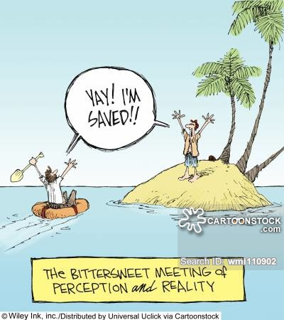
NEEDS & PERCEPTIONS

Slide 40
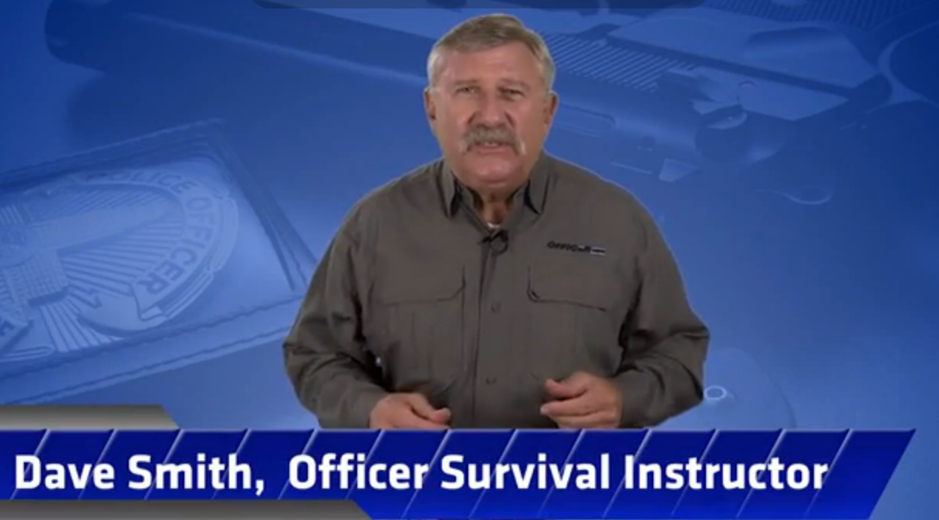
youtube.com/watch?v=9IIsNUh-GOU
Body Language 4 Min
Notes:
4 Min

Slide 41
The “WHY” of Their Behavior
Rationalize: most favorable light of speaker
Projecting: attributes own motives to others
Displacement: vent on or need a scapegoat
Repression: ignoring painful feelings
Self-Image: Protect or enhance their self-image
Role-Play: How we think we should act out
Rational Behavior: What is irrational?
Reaction-Formation: repress unacceptable drives,
      & Act in opposite ways
      “Just World” as a Coping Mechanism?
Notes:
The “WHY” of Behavior
Just World:
"You got what was coming to you“
"What goes around comes around“
"chickens come home to roost“
"You reap what you sow“
8 Min

Slide 42
Recognize the “NEEDS”: Maslow
Physiological: Survival (FIRST NEED)
Safety/Security: Personal, Financial, Health
Love/Belonging: Friends, Intimacy, Family
Esteem: Accepted by others, recognition
Know/Understand: Education, Learning
Aesthetic: Creativity, Beauty, Artistic
Self-Actualization: achieve their potential
What is motivating them?
Notes:
Recognize the “NEEDS”
11 Min
Turtle Feeding Example: Sleeps, Lives under Tunnel, only eats when feeling safe…..What are kids missing in this needs list?

Slide 43
The “NEED” Satisfaction Sequence
Specific daily process to attain necessary needs
• Survival • Psychological • Social
NEED: tension or stimulus driven
MENTAL ACTION: thinking or evaluation (how)
PROCESS: physical action to satisfy
SATISFACTION: when tension reduced = pleasure
Notes:
The “NEED” Satisfaction Sequence
12 Min

Slide 44

The “NEED”: Crisis Stimulus/Tension
Precipitating Event (real or perceived)
  Divorce, Job Loss, Death of a loved one
Impaired Social Functioning
  Mental, phobias, paranoia, etc
Non-Rational Emotional Response
  Emotion takes over, Anxiety, etc
      Coping Mechanisms?
Notes:
The “NEED” Satisfaction Sequence
15 Min

Slide 45
The “NEED”: Resolution?
Regain Control of Situation: safety first
  Remain calm, but concerned, and have reassuring manner
Guide them in regaining Control of their Behavior
  Identify precipitating event, how is it “real”
Law Enforcement action?
  Warning? Arrest? Squad?
Notes:
The “NEED” Satisfaction Sequence
20 Min

Slide 46
Verbal vs. Non-Verbal
Up to 90% of communication is not WHAT is said
  Tone
  Pitch
  Volume
  & Body Language
  Always go with body language (& non-verbal clues)!!
SurvivingVerbalConflict.com
Notes:
The “NEED” Satisfaction Sequence
20 Min

Slide 47
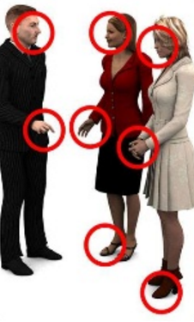
Kinesics: Reading Behaviors/Clues
“I’m lying to you.”
“I’m thinking about fleeing.”
“I’m irritated.”
“I’m suicidal/depressed.”
“I’m hiding something from you.”
“There are drugs in the car.”
“I’m gonna kill you.”
Others?
Notes:
Kinesics: Reading Behaviors/Clues
24 Min

Slide 48
Kinesics: Reading Behaviors/Clues
EMBLEMS: Verbal counterparts (cultural?)
  Middle finger, the “zero” fingers, peace sign
ILLUSTRATORS: Reinforce the verbal (cultural?)
  Nodding of the head when saying yes, waving of hands
AFFECTIVE DISPLAYS: emotions, mood, intent
  Subconscious level, smiles, frowns, grimaces
REGULATORS: Flow of the Conversation
  Yawn, murmurs, sighs, rubbing the forehead
ADAPTERS: Postural, timing
  Shifting, tapping feet, arms crossed
Notes:
Kinesics: Reading Behaviors/Clues
30 Min

Slide 49
Kinesics: Reading Behaviors/Clues
TIMING: What they do during the question? (WHY?)
  eye-contact, shrug, lips, lint, eyebrows, looking, scanning
CLUSTERS: Single action, clustered or missing action
  Context, totality of circumstances, triggered?
CONTINUITY: if in conflict, believe the body!
  We consciously lie, body is subconscious
CONVERSATIONAL: CADENCE CHANGE
  Mid-conversation? Rhythm, tempo, pace
Notes:
Kinesics: Reading Behaviors/Clues
35 Min

Slide 50
Kinesics: Reading Behaviors/Clues
SCANNING: Focused on surrounding area, eyes, head
TARGET GLANCE: Officer’s body or weapon(s), face
CLENCHING: Teeth or fists, trapezius muscles
BLINKING: Slower/faster than normal, 1000 yd stare
FIGHTING STANCE: Leg, clench, nostrils, verbal
FLANKING: more than one youth, behind officer
HESITATION: focused elsewhere, can’t multi-task
PERSONAL SPACE: invade? Step Back
Others? (next page)
Notes:
Kinesics: Reading Behaviors/Clues
44 Min

Slide 51
Kinesics: Reading Behaviors/Clues
Furrowed Brows
Pursed or tightly closed lips
Dilated pupils
Hidden hands or hands on hips, in pockets
Dip in leg
Flared nostrils
Mouth breathing or spitting
Face touching
Crossed arms
Walking around (flanking?)
Arguing, verbal threats
Stalling
Stretching, Head Roll, Neck
Notes:
Kinesics: Reading Behaviors/Clues
50 Min

Slide 52
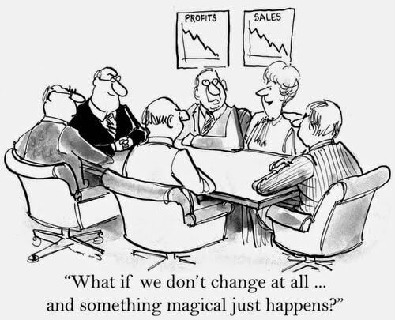
BEHAVIORAL CHANGE

Slide 53
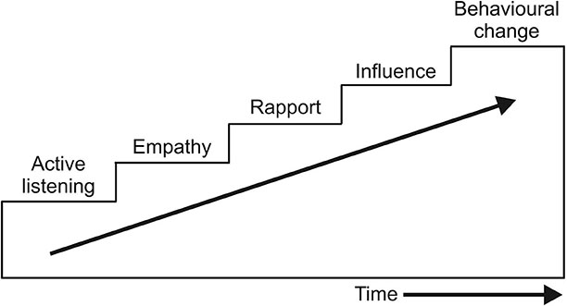
Behavioral Change Stairway
Notes:
Behavioral Change Stairway
1 Min

Slide 54
Active Listening Skills
Show interest in what is being stated
  If they mention it, it IS important
See & Understand their “perspective”
Listen more than talk (2 ears, 1 mouth)
Listen carefully to what is being stated
Listen for emotions
Listen for content (the story)
Frederick J. Lanceley, Director, Crisis Negotiation Associates, Inc
Notes:
Want them to know how difficult it is to negotiate a point that you personally don't agree with like religion. Or even more difficult, negotiate a point that makes no sense because the suspect took drugs/alcohol or they didn't take prescribed pills and now they want to argue why chickens are actually amphibians and not reptiles because McDonalds is closed.
2 Min

Slide 55
Active Listening Skills #1
Emotion Labeling
  Respond to the emotions that are “heard”
  Identify the feeling
    You sound…
    You seem…
    I hear...
  Demonstrates YOU are listening to them
  Listen for conflicts
  Be aware of missing emotions
Notes:
Active Listening Skills
3 Min

Slide 56
Active Listening Skills #2
Paraphrasing
  Restatement
  Summarize what you just heard
  Clarifies what has been stated
  Creates empathy and rapport
  Makes youth non-defensive by using their words
    Are you saying…
    Are you telling me…
Notes:
Active Listening Skills
4 Min

Slide 57
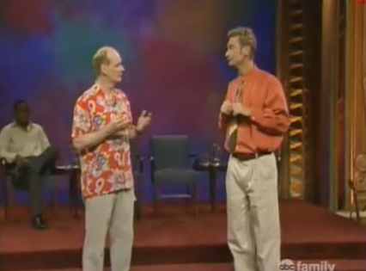
youtube.com/watch?v=i2uD81BD8OI
Paraphrase 3.5 Min
Notes:
8 Min

Slide 58
Active Listening Skills #3
Reflecting/Mirroring
  Repeating back the last word or phrase said by youth
  Asks for more intel without guiding direction
Notes:
Active Listening Skills
9 Min

Slide 59
Active Listening Skills #4
Effective pause (silence)
  Most people feel awkward with silence
  Can provoke the youth into talking
  Use before and after YOU have communicated an important message (intensifies meaning)
Notes:
Active Listening Skills
10 Min

Slide 60
Active Listening Skills #5
Minimal encouragers
  Sounds you can make showing your interest
  “Oh”, “When”, “Really?”, etc
  Does not interfere with conversation flow
  Helps build rapport
  Encourages the subject to continue TALKING
Notes:
Active Listening Skills
11 Min

Slide 61
Active Listening Skills #6
“I” messages
  Shows how you are interpreting what is being said
  Non-threatening approach
  Why we feel a certain way
  What they can do to help remedy situation
  Can slow down manipulation and verbal attacks
  I feel….when you…..because…..
    I feel uneasy about that request….
    I feel hurt when you…..
Notes:
Active Listening Skills
12 Min

Slide 62
Active Listening Skills: 5 W's
Open ended questions
  5 W’s + How
  Cannot be answered with “Yes” or “No”
  Provokes conversation
  Demonstrates interest in their feelings
  Closed ended questions gives appearance of interrogation
Notes:
Active Listening Skills
13 Min

Slide 63
Phrases that Establish Empathy
The ultimate EMPATHETIC statement:
  “Let me be sure I heard what you just said.”
  14 Benefits to paraphrasing……
Why?
Notes:
Phrases that Establish Empathy
13.5 Min
Why? Because it shows the other person that you are deeply interested in what they said. Does not show blame.

Slide 64
14 Benefits to Paraphrasing:
You hook them to listening…
You have taken control…
Immediate feedback, not misunderstood later
Allows them to correct anything that they said
Makes them a better listener (to their own words)
Creating Empathy, they believe you are interested
Attempting to get it right, not be right
Notes:
Phrases that Establish Empathy
15 Min

Slide 65
14 Benefits to Paraphrasing (cont):
Sonic Intention: did they say it out loud? just their mind?
Clarifying effect for witnesses, save face?
Avoids “putting words in other people’s mouths”
Ask for reverse paraphrasing: did they hear you?
Safeguard against missing details
Golden rule, they will see you as fair and treat you well
Reinforces details in your memory
Notes:
Phrases that Establish Empathy
16 Min

Slide 66
5 Steps to Persuasion (Appeal)
Ask
Set Context
Present Options
Confirm
Act
(Ethical Appeal)
Ernest desire to help
(Reasonable Appeal)
Logical, Common Sense
(Personal Appeal)
Show the Benefits
(Practical Appeal)
Humor, Redirection, Refocus
(Determination of
Appropriate Action)
Notes:
5 Steps to Persuasion
20 Min

Slide 67
5 Steps to Persuasion: LEAPS
LISTEN: Look interested
EMPATHIZE: Don’t agree, but understand
ASK: 5 W’s, Opinion-Seeking, Direct or Leading
PARAPHRASE: Repeat back without emotion/tone
SUMMARIZE: Condense into concise statement
  Brief, Concise, Inarguable
Notes:
5 Steps to Persuasion
25 Min

Slide 68
What NOT to do:
OVER STERN: try to avoid direct, one-way orders
INDIFFERENCE: avoid the “I don’t give a !@#%”
INDECISIVENESS: avoid wishy-washy
CARELESSNESS: avoid over-confidence, be aware
Notes:
5 Steps to Persuasion
29 Min

Slide 69
Negotiation Strategy & Tactics
Intel: basics you would normally get on any call
Establish Problem-Solving Climate
Build Trust (will eventually help pursade)
Avoid Forcing “Your” Climate
Attempt to calm the subject: words, tone, voice
Attempt to distract from original problem
Stall for Time
Notes:
Negotiation Strategy & Tactics
35 Min
Whisper during a verbal argument and see if it lowers the other’s voice

Slide 70
Negotiation Strategy & Tactics (cont)
Avoid arguing/provoking
Help youth “Save Face” (not lose)
Active Listening
Deal with smaller issues first: build foundation
Present both sides of the argument: objective
Point out Similarities: rapport and trust
Delayed Compliance: think about it, sleep on it
Keep hope alive: of winning for both sides
Notes:
Negotiation Strategy & Tactics
35 Min

Slide 71
Negotiation Words and Phrases
Could you tell me about it?
I would like to hear your side.
Could you share that with me?
I guess that’s pretty important to you.
That’s interesting, tell me more about …
Together, we can work this out.
Your suggestions?
Notes:
Negotiation Strategy & Tactics
37 Min

Slide 72
Youth Deliberate/Planned Behavior
REMIND:
  Subtle words/signals, non-threatening, private/quiet
  i.e. “I understand you without swearing…”
EXPLAIN:
  Simple, non-threatening consequences, “if-then”, your choice
INSTRUCT:
  Clear, Firm, Courteous, Facts
  Directions to quickly correct behavior
    State Specific issue at hand and effects of mis-behavior
http://de-escalate.org/
Notes:
JV De-Escalation from http://de-escalate.org/
41 Min

Slide 73
Youth Emotional/Impulse Behavior
SPACE/TIME:
  To vent, show respect, non-threatening, don’t crowd
REFLECTIVE LISTENING (Active):
  Shows comforting, reaffirming, don’t disagree
  More verbal = less physical
POSITIVE OPTIONS:
  Ask them for positive options available
  Try not to suggest unless they don’t have any
http://de-escalate.org/
Notes:
JV De-Escalation from http://de-escalate.org/
44 Min

Slide 74
SCENARIOS
Basketball Game:
Fred’s Son, Ref call, prior issue
Answers:
Does crowd play a role?
Racial?
How do you handle?
Notes:
45 Min

Slide 75
SCENARIOS
Basketball Game:
Students from opposing team
Come over to home side
Refuse to leave a “public” area
Answers:
Does your school allow it?
How do you remove them?
Notes:
46 Min

Slide 76
SCENARIOS
Suspended student:
Parking Lot, profanities
disorderly conduct, angry
Answers:
Do you go hands on?
Do you cite him?
Notes:
47 Min

Slide 77

Resources
Verbal Judo
George Thompson

Slide 78
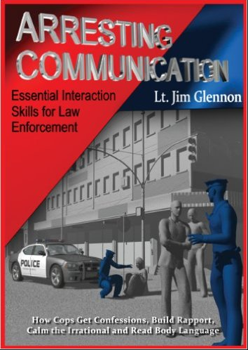
Resources
Arresting Communication
Lt. Jim Glennon

Slide 79
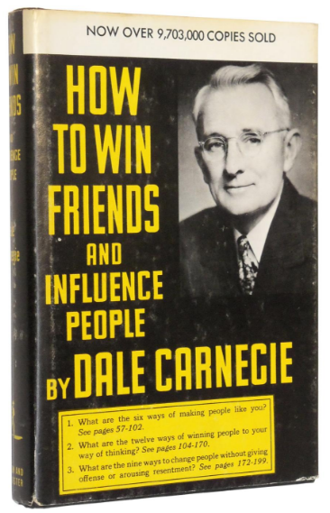
Resources
How to Win Friends & Influence People
Dale Carnegie

Slide 80
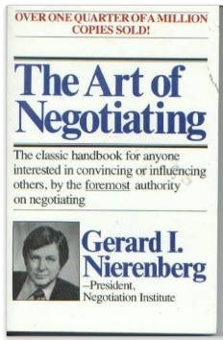
Resources
The Art of Negotiating
Gerard Nierenberg

Slide 81
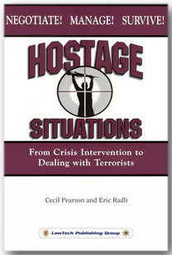
Resources
Hostage Situations
Cecil Pearson, Eric Radli

Slide 82
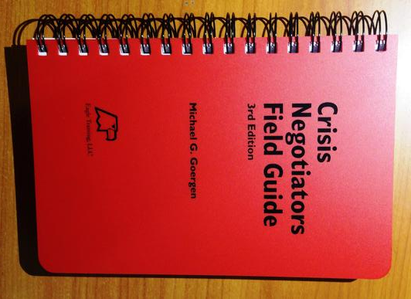
Resources
Crisis Negotiators Field Guide (Eagle Training)
Michael G. Goergen

Slide 83

Resources
The Gift of Fear: And Other Survival Signals That Protect Us from Violence
Gavin de Becker

Slide 84

Resources
Dolan Consulting Group
Surviving Verbal Conflict
www.dolanconsultinggroup.com

Slide 85
Questions?
Retired Officer Adam Gongwer
SRO@SRO101.com
419-571-1031 (Cell)
Download this powerpoint:
Sro101.com (click on downloads)

